Slide 1
News Headline Matching User Research Report

Slide 2



The focus was to test the currently designed prototype.
This study allowed a deeper dive into potential improvements by providing user feedback on the design, enabling a more user centred approach to be created from the insights we have gained.
Understand digital behaviors
Research Objectives
Look at how users interact with the prototype and use different variants of the UI proposed.
Hear user feedback
Learn more about how users interact with the prototype
Share insights
Share results back to the teams to bring the voice of the user into the design process.

Slide 3








Methodology
Desk Research
Focus Group
Interview
Journey Mapping
A/B Testing
Analytics
Survey
User Testing

Slide 4
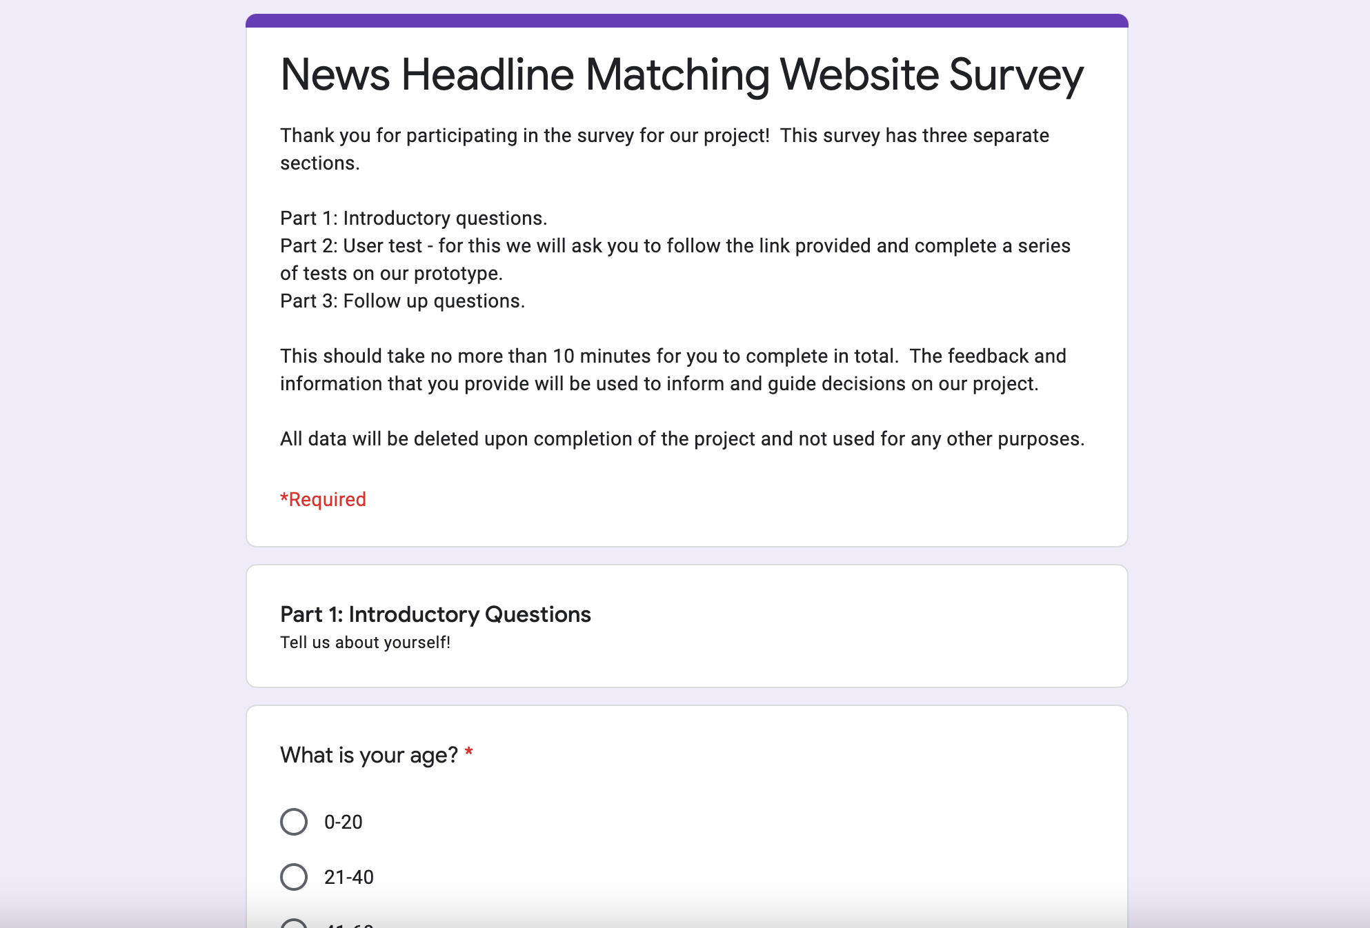
Methodology | Unmoderated Testing / Survey
Connected with 10 people via Google Surveys
Unmoderated User Tests on Google Surveys
Asking users:
Initial demographic questions
Free roam use of the prototype design
Follow up questions about the design choices
Link to Survey questions:
Survey
Links to prototype used:
Prototype
Seattle
San Francisco Silicon Valley
NYC
(Union Square and Chelsea)
Sydney

Slide 5
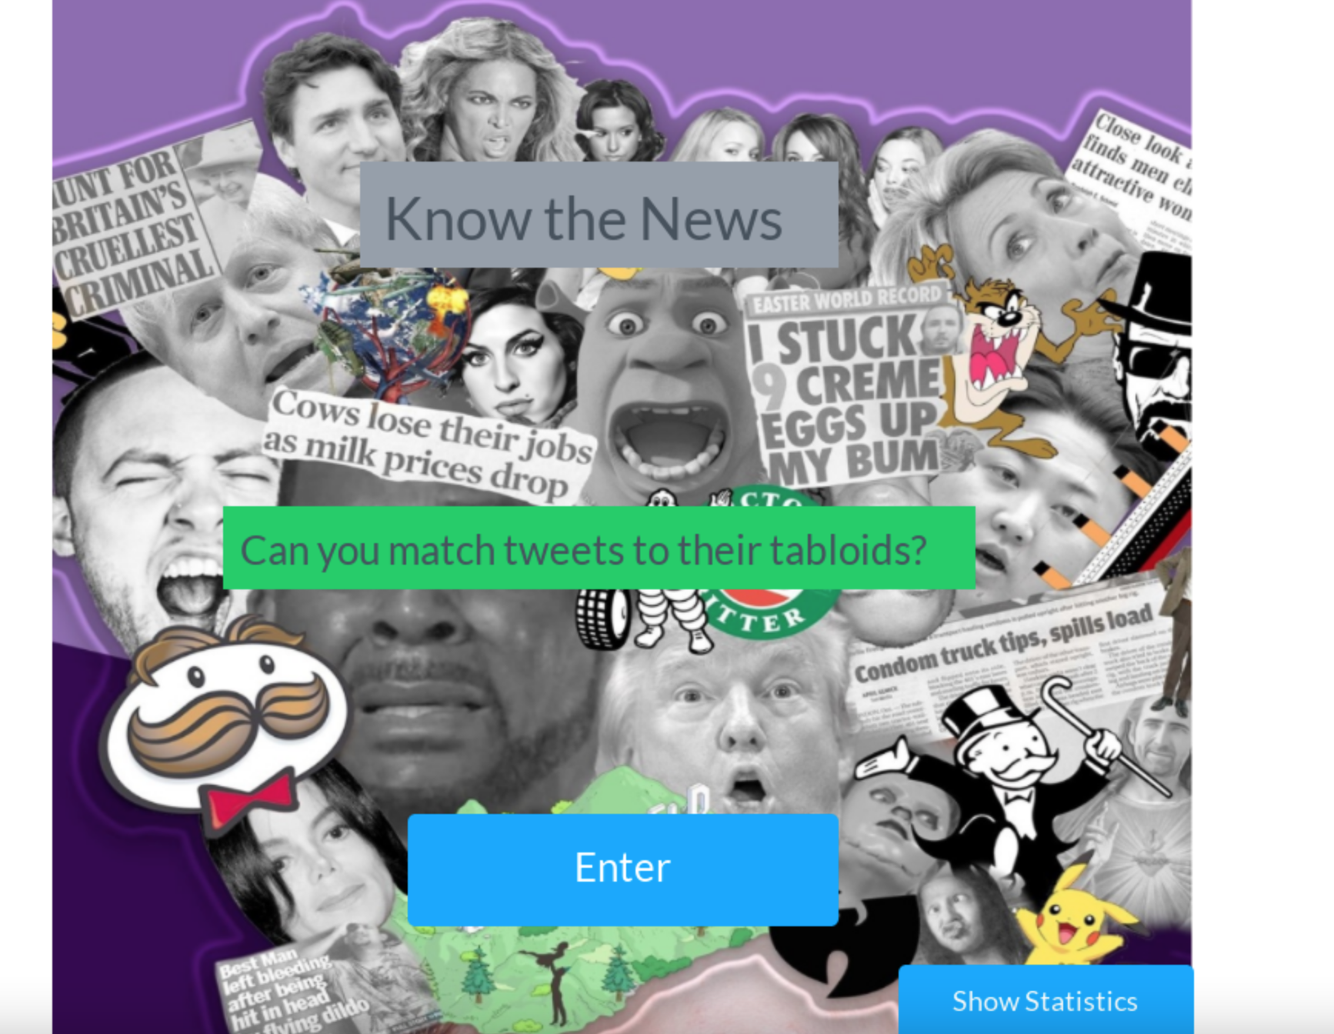
Methodology | Moderated User Test
Connected with 2 people via Zoom
Performed due to prototype limitations
Moderated User Test via Zoom
Asking users:
Open ended questions regarding design of specific pages
Complete a question within the prototype.
Links to prototype used:
Prototype
Seattle
San Francisco Silicon Valley
NYC
(Union Square and Chelsea)
Sydney

Slide 6
Survey Participants | Overview
Seattle
San Francisco Silicon Valley
NYC
(Union Square and Chelsea)
Sydney

Slide 7

Moderated User Participants | Overview
Participant One:
39F – GP
Manchester
Participant Two:
35M – Front End Developer
Manchester
Seattle
San Francisco Silicon Valley
NYC
(Union Square and Chelsea)
Sydney

Slide 8
Unmoderated Survey - Insights
Survey

Slide 9
Insight 1
Some users did not understand the core concept of the game
Survey
Q: In your own words, please could you describe the objective of this game?
“Test of Knowledge? …”
“Random clickiness”
Opportunity
Create subtitles or add additional stages to present the concept/idea behind the game

Slide 10
Insight 2 – Mobile?
Survey
“I was unable to make game work on iPhone”
“I couldn’t drag and drop the answers (using web browser on iPhone)”
“…possibly dodgy android Firefox nightly than the site though“
Opportunity
Do we need to investigate Android / iOS compatibility of the future website?

Slide 11
Insight 3 – Prototype Limitations
“I was only able to click on the tweet, which moved it into the correct box for me”
Survey
“The tiles on the first page, the headlines could have been in boxes
to make the drag and drop easier to use…”
“Matching seems to be functionally broken and always moved
the text to the right-hand option…”
Opportunity
Build and re-test with a coded prototype or find a UX tool with drag and drop capabilities.

Slide 12
Insight 4 - Title of the Single Page Application
Survey
…continued in Moderated User Tests

Slide 13
Moderated User Test - Insights
User Testing

Slide 14
Insight 4 - Title of the Single Page Application
Survey
Participant One: Could not think of anything at the time, but afterwards felt Know the News was good
Participant Two: “I quite like Know the News, to be fair, I think it’s alright.
Opportunity
Combining survey and moderated results – Know the News is the most popular title for the application.
Will do further research in future user tests if we need more confidence in the applications name.
…continued in Moderated User Tests

Slide 15
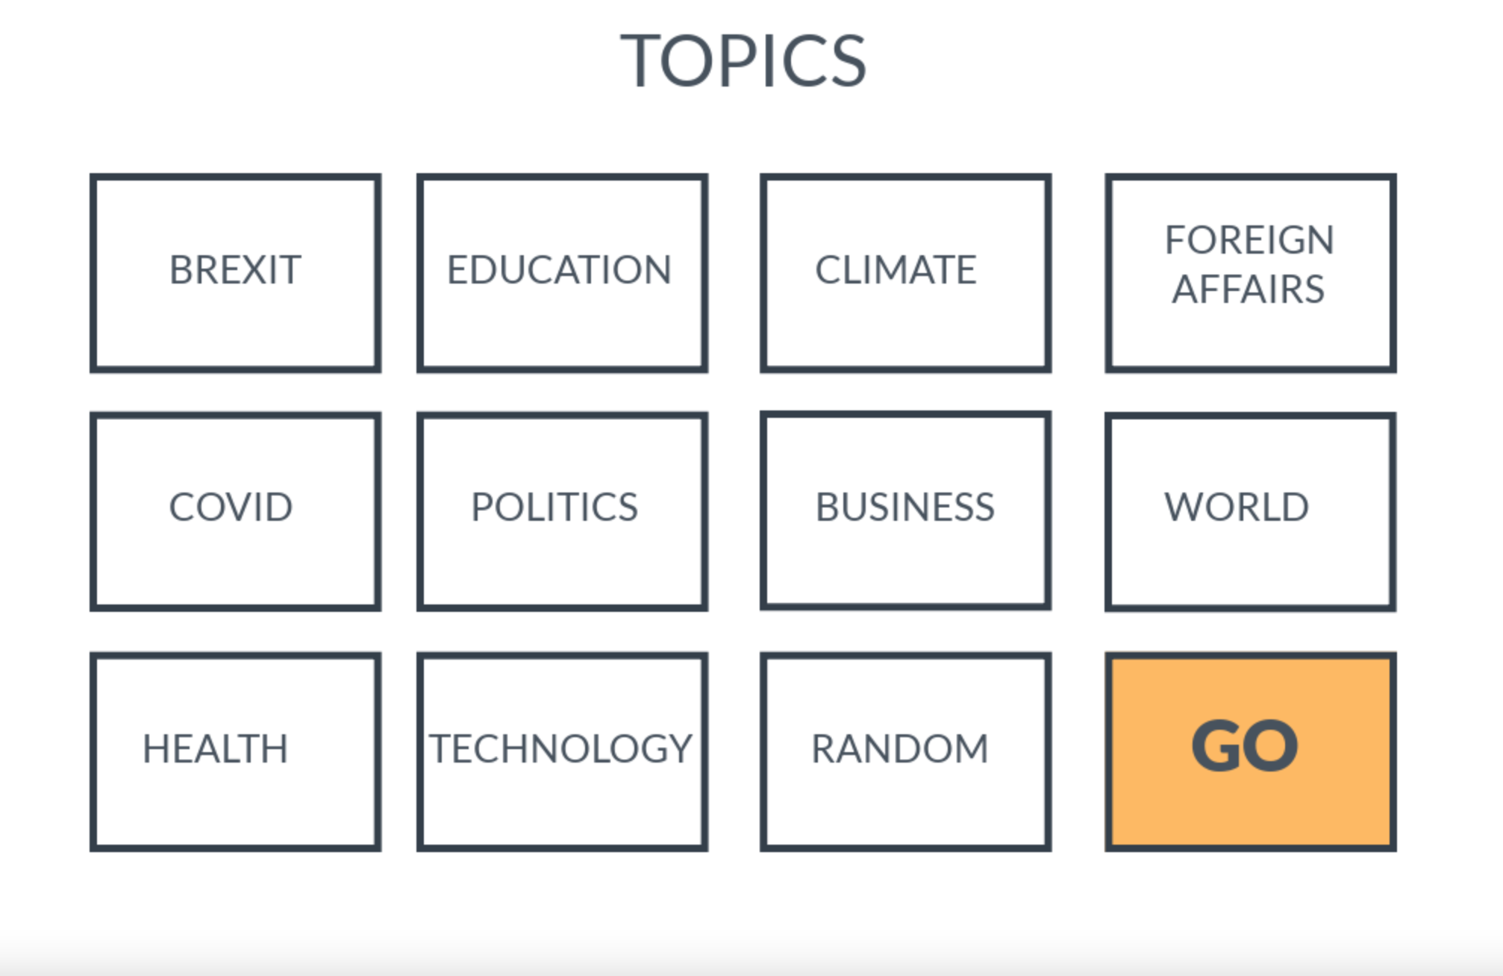
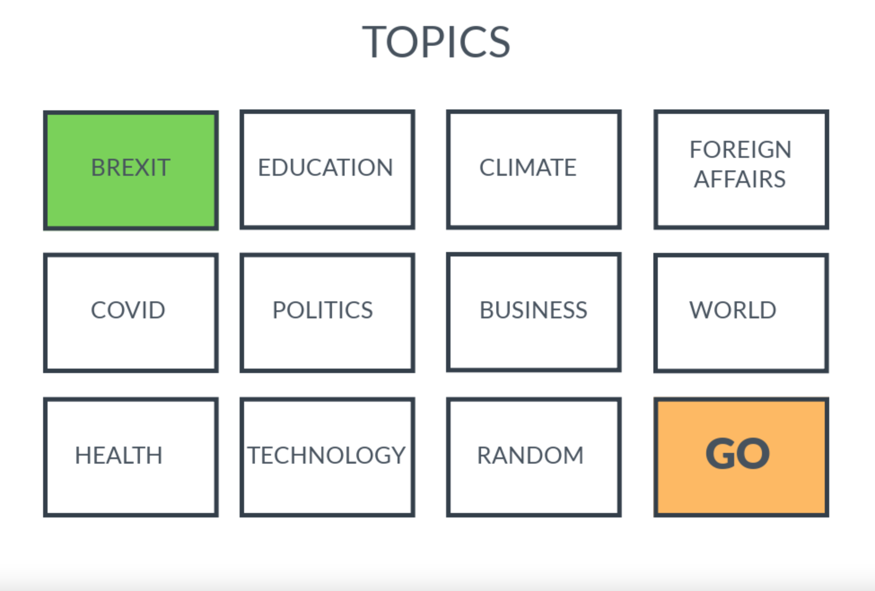
Stimuli – Selection Pages
User Testing
->
Design Decision: Are people allowed multiple questions, or just one at a time?

Slide 16
Stimuli – Selection Pages
User Testing
Participant 2: I probably expect a bit of an explanation below the title… however it is obvious I am supposed
to click these.”
“I think from my first impressions that this is a game… I’d be familiar enough to click on the buttons however
a bit of an explanation would be best to go with it, so you know how many to pick.”
Opportunity
Create subtitles or add additional stages to present
the concept/idea behind the game

Slide 17
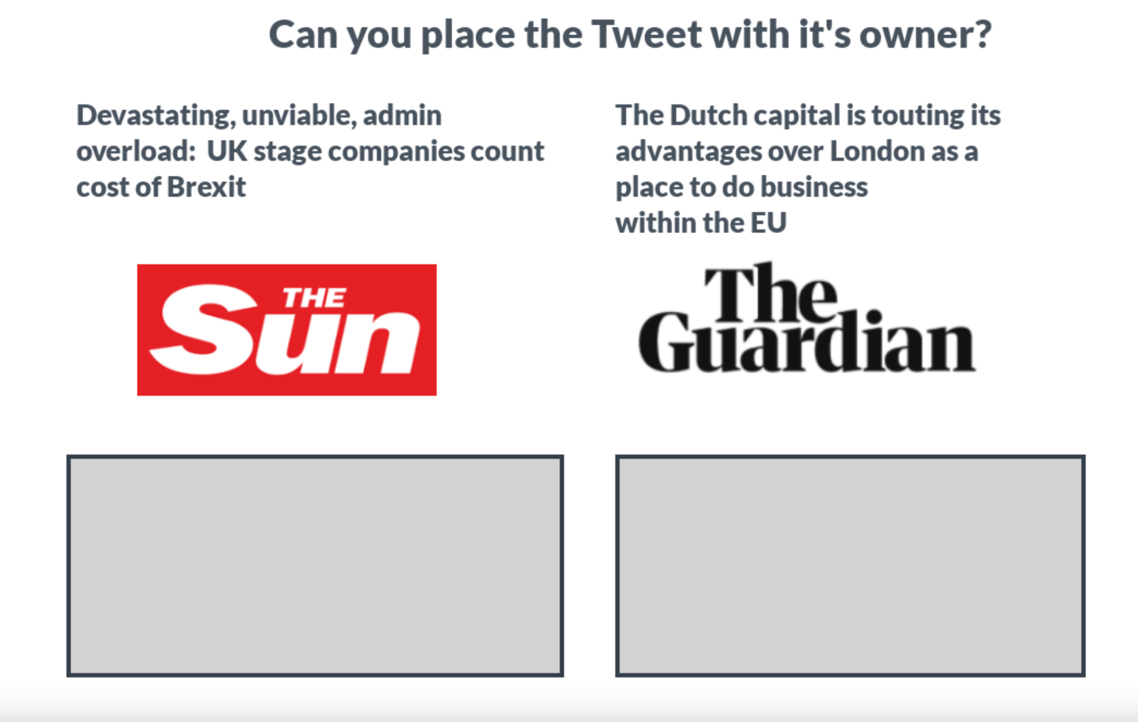
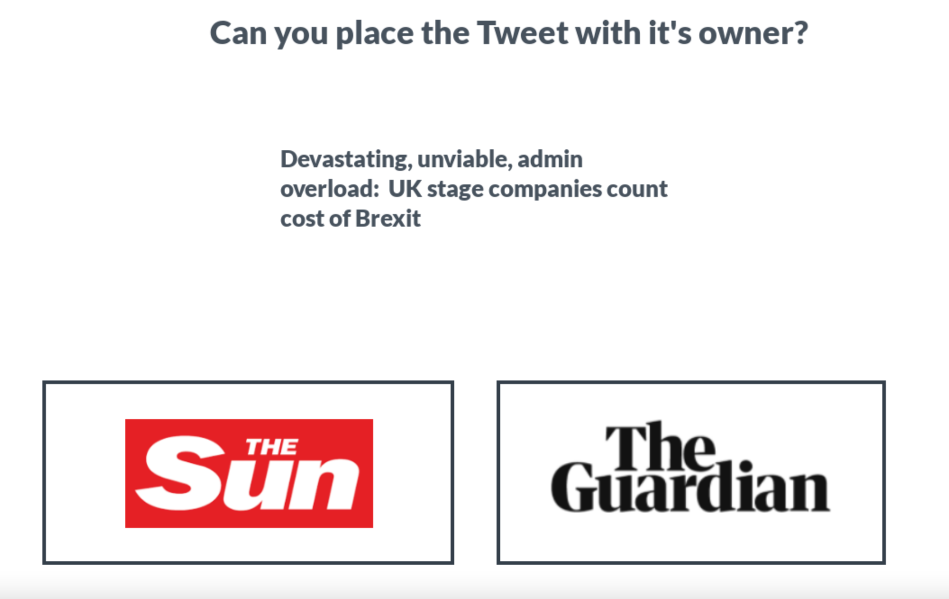
Stimuli – Question Pages
User Testing

Slide 18
Stimuli – Question Pages
User Testing
Participant One: “I think that one (2) is easier… having one tweet was OK, I mean having two to compare,
I suppose if you aren’t too sure, then you’ve got a second chance of realizing which one is which as one might be
easier to decide / get it right?”
Participant Two: “I think it is more obvious that you are incorrect (with 2) however would still be nice to see
both tweets”
(1)
(2)

Slide 19
Summary
Create subtitles or add additional stages to present the concept/idea behind the game
Do we need to investigate Android / iOS compatibility of the future website?
Know the News is currently most popular name
One or Two Tweets per question? Two most popular.
Limitations of Prototype – More testing will be useful once front end is more developed.
Mobile compatibility?

